Slide 1
Ames House Sale Price Statistical Analysis
Group 9
Deyvis Dalman
Jannatul Naeema
Chelsea Squires
Devanshi Patel
Utsav Agrawal

Slide 2

Objective
Project is based on a housing sales price dataset for Ames, a city in Iowa, home to Iowa State university
As buying and selling a home is a big undertaking for both buyers and sellers.
The sale price for a home is impacted by not just the number of bedrooms and bathrooms but a multitude other variables
Team wanted to apply Statistical methods from this course and carryout both regression and classification analysis on the dataset
These analysis will help us determine relationships between different predictors, response variables and predicting house sale prices
* By User:Raivena - http://commons.wikimedia.org/wiki/File:Ames_IA_-_train_station.jpghttp://en.wikipedia.org/wiki/File:Isumarstonwatertower.jpghttp://en.wikipedia.org/wiki/File:Fountain_of_Four_Seasons.jpghttp://en.wikipedia.org/wiki/File:Isubeardshear2008.jpghttp://en.wikipedia.org/wiki/File:ISU_Alumni_Hall.jpghttp://en.wikipedia.org/wiki/File:RG_Lake_Helen.jpghttp://en.wikipedia.org/wiki/File:RG_Christina_Reiman_Butterfly_Wing.jpghttp://upload.wikimedia.org/wikipedia/commons/thumb/1/16/Ames_Iowa_Main_Street.jpg/250px-Ames_Iowa_Main_Street.jpg, CC BY 3.0, https://commons.wikimedia.org/w/index.php?curid=15524286

Slide 3
Introduction & Dataset
Dataset Description:
Dataset has 80 variables and consists of 1460 rows, describing every aspect of residential houses for sale in Ames, Iowa
This is an opensource dataset from Kaggle, licensed for academic use
It's part of a long running competition on Kaggle to predict house sale prices
Why this Dataset:
Although the dataset is local to Ames, we believe its analysis may be generalized for multiple locations
This could help homebuyers in making buying and selling decisions
Key Question:
Are there statistically significant variables related to the Sales Price of a residential home in Ames, Iowa? Are these variables consistent based on analytical approach and which approach performs best?
Source: https://www.kaggle.com/competitions/house-prices-advanced-regression-techniques/data

Slide 4
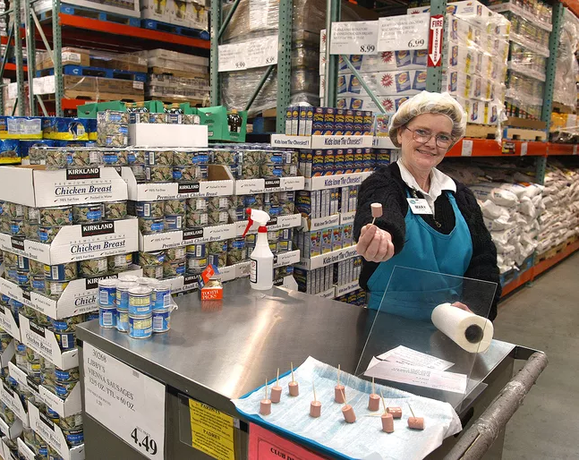
Data Preparation & Sampling
The dataset featured "NA" were changed to "No" , "None" or 0 values in the data based on the appropriate category
The numerical response variable "SalesPrice" was used to generate "PriceGroup" - a categorical response variable of 5 equal populations based on sales price
Then Sampling was used to subset 75% of dataset into training set and 25% of dataset into testing dataset

Slide 5
Categorical Variable Breakdown
Price Group | n | Price Range
A | 292 | $34.9-124K
B | 292 | $124-147K
C | 292 | $147-179.2
D | 292 | $179.2-230K
E | 292 | $230-755K

Slide 6
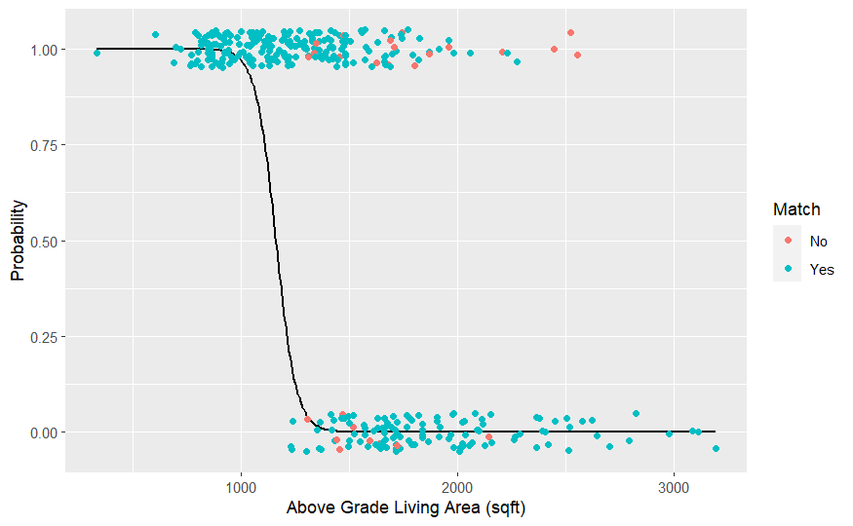
Logistic Regression
Binomial Categorical Adjustment: SalesPrice was categorized as either above or below average ($180,921.20)
Systematic approach to variable reduction (variance and interdependencies) from 86 to 6
Significant Variables: Living Area (shown), Overall Quality, Year of Remodel, Total Basement Area, Lot Area and Garage Area
93% predictive match and all VIF values <4.

Slide 7
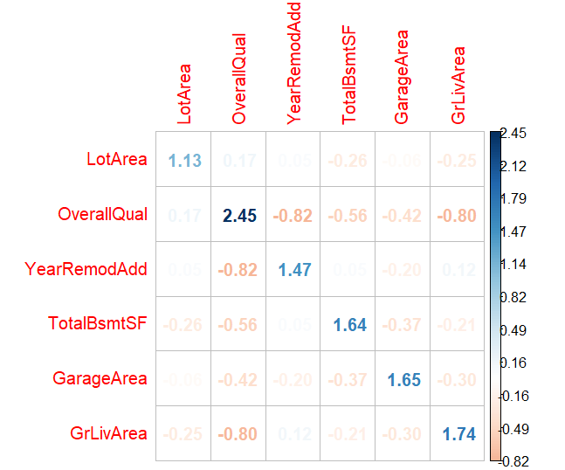
Logistic Regression
Binomial Categorical Adjustment: SalesPrice was categorized as either above or below average ($180,921.20)
Systematic approach to variable reduction (variance and interdependencies) from 86 to 6
Significant Variables: Living Area (shown), Overall Quality, Year of Remodel, Total Basement Area, Lot Area and Garage Area
93% predictive match and all VIF values <4.

Slide 8
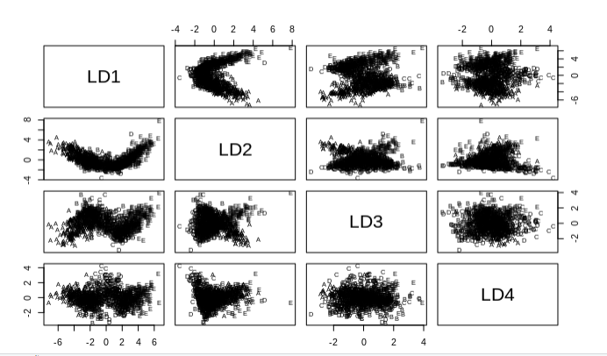
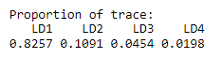
Linear Discriminant Analysis
priceGroup was used for the classification in the LDA model.
Used extensive model which featured 24 predictors.

Slide 9
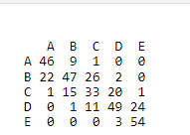
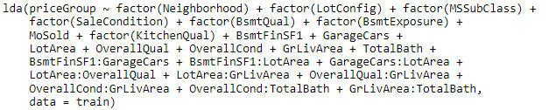
Linear Discriminant Analysis
The resulting LDA model gave a prediction rate of 62.74% (229/365)
Predicted
Actual

Slide 10
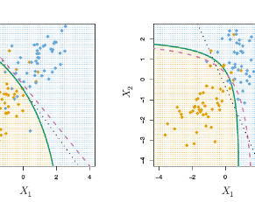
Quadratic Discriminant Analysis
Linear Discriminant Analysis (LDA) makes several assumptions when applied to a dataset:
Normality Assumption
Equal Variance Assumption
Independence Assumption
Classes are separable
Quadratic Discriminant Analysis (QDA) does not require the equal variance assumption that is necessary for Linear Discriminant Analysis (LDA).

Slide 11
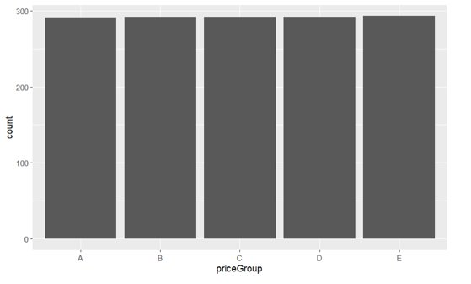
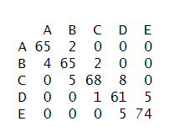
Quadratic Discriminant Analysis
Step 1: Checking class distribution, each category has almost equal number of samples.
Step 2: Making a model out of 26 predictor variables.
Step 3: Find accuracy of the model by confusion matrix.
The resulting QDA model gave a prediction rate of 0.622
1
Actual
3
Predicted
2

Slide 12
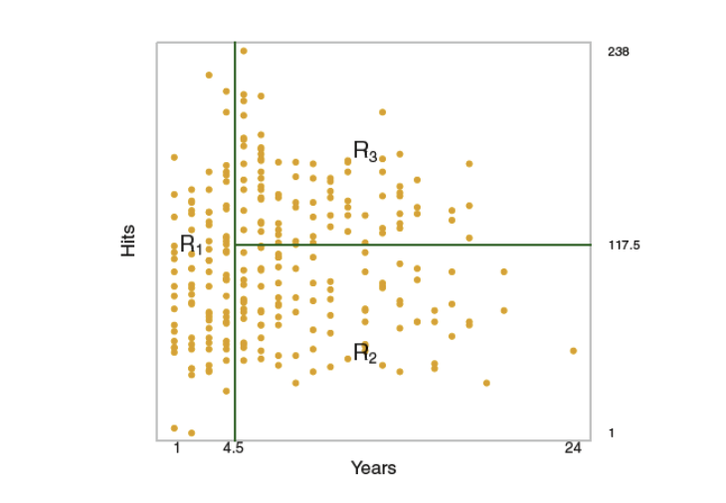
Regression & Classification Tree
Regression tree & Classification tree are a series of splitting rules starting at the top of the tree
Following is the tree process
We divide the predictor space – that is, the set of possible values for X1, X2, . . . . Xp (the predictors) – into J distinct and non-overlapping regions R1, R2, . . . , RJ
For every observation that falls into the region Rj , we make the same prediction, which is simply the mean response value for the training observations in Rj

Slide 13

Regression & Classification Tree
Regression tree was ran on Saleprice and a classification tree was ran on Price Group created earlier during data wrangling
Predictor Variables used for both Regression and classification tree: Neighborhood,LotConfig,RoofMatl,PoolArea,MoSold,KitchenQual,BsmtFinSF1,GarageCars,LotArea,OverallQual,OverallCond,GrLivArea,TotalBath
Both trees have 11 nodes and do-not require pruning on running CV tree analysis
Decision tree gave a RMSE of ~500 on test dataset with A Classification tree was ran on the priceGroup to compare with the LDA Classification tree gives an accuracy of of 56% on the classification

Slide 14
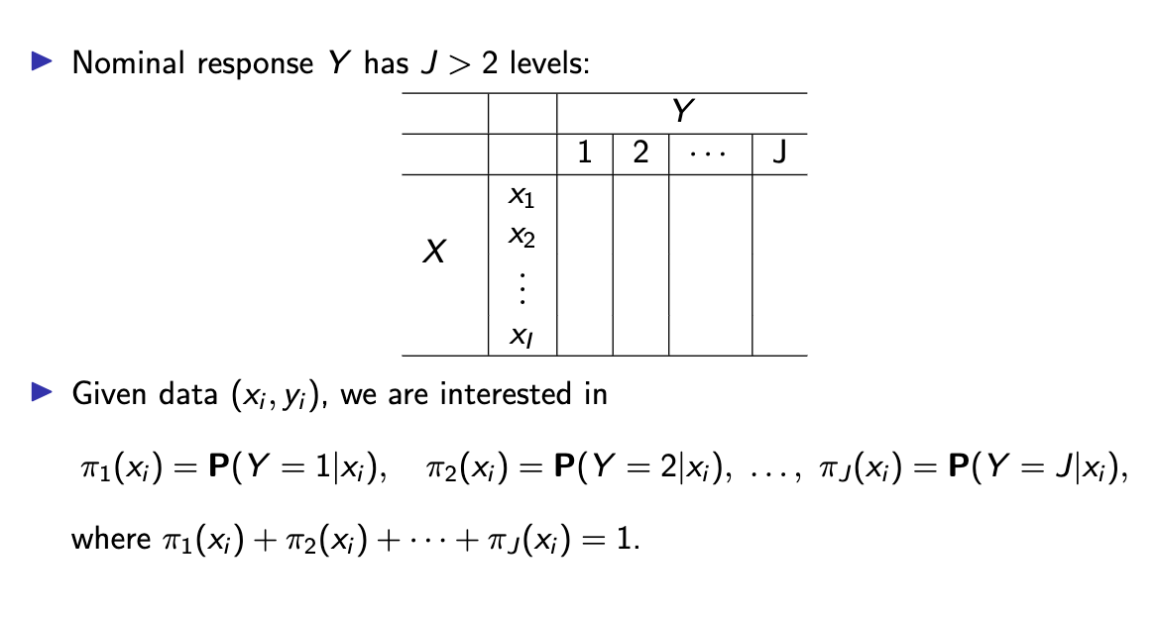
Multinomial Regression
As a team wanted to narrow down on variables that impact sale
A simpler Saleprice classification of High (>240,000), Medium (130,000 to 240,000) & Low(130,000<) is created

Slide 15
Multinomial Regression
In first iteration we ran a multinomial regression only on ”Neighbourhood” variable. Model gave accuracy of 74%
In the next iteration more variables including “Neighborhood”, “OverallQual,“OverallCond”,“GarageType”,LotConfig, “SaleCondition” & “Basement Exposure”
Using Multinomial regression an accuracy of 80% was achieved for the both training & test dataset

Slide 16
Model validation: k folds cross-validation
The cross-validation errors of QDA Model : 0.434
The cross-validation errors of the classification tree: 0.491
LDA Model

Slide 17
Result Comparison
Model​ | Response Variable | nVars | Significant Variables​ | Accuracy​
Logistic Regression​ | priceGroup | 6 | Living Area, Overall Quality, Year of Remodel, Total Basement Area, Lot Area, Garage Area​ | 93%​
LDA​ | priceGroup | 15 | ​Lot Configuration, MS Sub Class, Sale Condition, Basement Quality, Basement Exposure, Month Sold, Kitchen Quality, Basement Area, # of Car Garage, Lot Area, Overall Quality, Overall Condition, Living Area, Total # Baths | ​63%
QDA​ | priceGroup | 26 | ​Lot Frontage, Lot Area, Overall Quality, Overall Condition, Year Build, Year Remodel Added, Basement Area, Living Area, Basement Bathrooms, Fireplaces, Garage Year Built, # of Cars in Garage, Garage Area, Wood Deck Area, Total Porch Area, Year Sold | ​62%
Regression Decision Tree​ | Saleprice | 13 | ​Neighborhood, Lot Configuration ,Roof Material, Pool Area, Month Sold, Kitchen Quality, Basement Area, #Cars in Garage, Lot Area, Overall Quality, Overall Condition, Living Area, Total # of Baths | ​44%
Classification Tree | priceGroup | 13 | ​Neighborhood, Lot Configuration ,Roof Material, Pool Area, Month Sold, Kitchen Quality, Basement Area, #Cars in Garage, Lot Area, Overall Quality, Overall Condition, Living Area, Total # of Baths | ​56%
Multinomial Regression​ | Saleprice_Class | 7 | ​Neighborhood, Overall Quality, Overall Condition, Garage Type, Lot Configuration, Sale Condition & Basement Exposure | ​80%

Slide 18
Conclusion
Logistic Regression, LDA, QDA, Decision Trees, and Multinomial Regression were used to determine the predictors of house prices
A series of categorical adjustments were used to determine which class of sale price each listing fell into
The models ranged in accuracy from 44-93% with variable selection being significant to model performance
LDA was not valid as the assumptions were not met.
Living Area, Overall Quality, and Lot Area were significant across all models while Basement Area and Overall Condition were significant in all but one model.

Slide 19
Thank You

Slide 20

Questions

